Slide 1

Data and Expressions
Chapter 2
In PowerPoint, click on the speaker icon then the “play” button to hear audio narration.

Slide 2
Objectives
You will be able to:
Use the Java String class
and do String concatenation
Define and use variables in a Java program
Understand and use the Java primitive data types
Write expressions in a Java program
Write an interactive Java program
One that gets input from a user.

Slide 3
Character Strings
A string of characters can be represented as a string literal by putting double quotes around the text:
System.out.println("Hello, World!");
Examples:
"123 Main Street"
"X"
""
A String Literal

Slide 4

The println Method
In the Lincoln program, we invoked the println method to display a character string on the screen.
System.out.println ("Whatever you are, be a good one.");
System.out is an object that has the ability to display characters on the screen
using its println method
The println method takes a single parameter
A character string to be displayed on the screen
The value that we supply for the parameter is called the argument.

Slide 5
Summary
System.out.println ("Whatever you are, be a good one.");
object
method
name
information provided to the method
(argument)

Slide 6
The print Method
The System.out object provides another service as well.
The print method is similar to the println method, except that it does not advance to the next line.
Therefore anything printed after a print statement will appear on the same line.

Slide 7
Countdown.java
//********************************************************************
// Countdown.java Author: Lewis/Loftus
//
// Demonstrates the difference between print and println.
//********************************************************************
public class Countdown
{
//-----------------------------------------------------------------
// Prints two lines of output representing a rocket countdown.
//-----------------------------------------------------------------
public static void main (String[] args)
{
System.out.print ("Three... ");
System.out.print ("Two... ");
System.out.print ("One... ");
System.out.print ("Zero... ");
System.out.println ("Liftoff!");
System.out.println ("Houston, we have a problem.");
}
}
Copyright © 2012 Pearson Education, Inc.

Slide 8
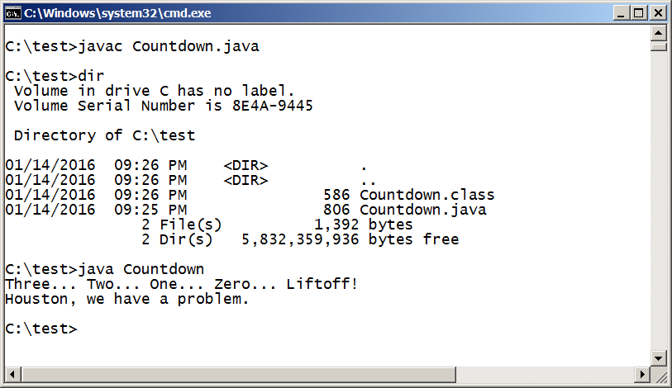
Running Countdown.java
Program output

Slide 9
String Concatenation
A string literal cannot be broken across two lines in a program.
The string concatenation operator (+) is used to append one string to the end of another.
"Peanut butter " + "and jelly"

Slide 10
The + Operator
The + operator is also used for arithmetic addition.
The function that it performs depends on the type of the information on which it operates.
"Operator overloading"

Slide 11
The + Operator
If both operands are strings, the + operator performs string concatenation.
println ("Peanut butter " + "and jelly");
outputs
Peanut butter and jelly

Slide 12
The + Operator
If both operands are numeric, the + operator adds them.
println( 24 + 45 )
outputs
69

Slide 13
The + Operator
If one operand is a string and the other is a number, the + operator also performs string concatenation, using the string representation of the number.
println ( "The number following forty-four is " + 45);
outputs
The number following forty-four is 45
println( 45 + " is the number following 44");
outputs
45 is the number following 44

Slide 14
The + Operator
When there are multiple + operators in an expression, the expression is evaluated left to right
System.out.println ("24 and 45 concatenated: " + 24 + 45);
outputs
24 and 45 concatenated: 2445

Slide 15

The + Operator
When there are multiple + operators in an expression, the expression is evaluated left to right
but parentheses can be used to force the order.
Subexpressions inside parentheses are evaluated first.
System.out.println ("24 and 45 added: " + (24 + 45));
outputs
24 and 45 added: 69
In PowerPoint, click on the slide to display successive lines.

Slide 16
Exercise
What output is produced by the following program statements?
A. System.out.println("6" + "7" + 8 + 9);
B. System.out.println( 6 + 7 + "8" + "9");
C. System.out.println("6" + "7" + (8 + 9));
Try it!
In PowerPoint, click on the slide to display successive lines.

Slide 17
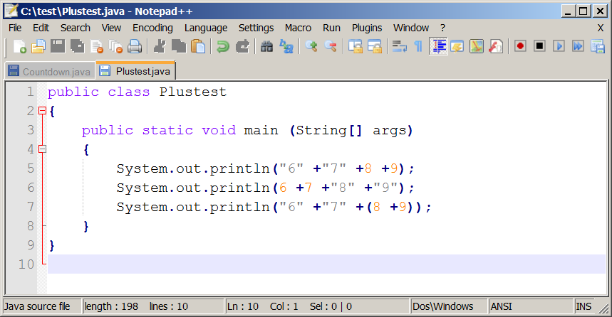
Plustest.java in Notepad++

Slide 18
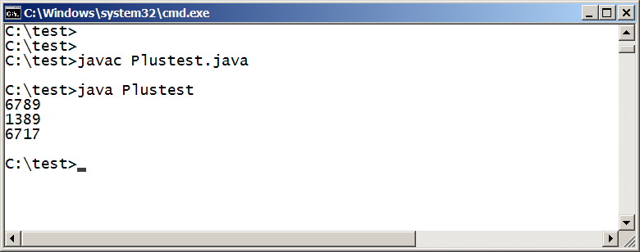
Running Plustest
Can you explain why is result is what it is?
"6" +"7" + 8 + 9
6 + 7 + "8" +"9"
"6" +"7" + (8 + 9)
In PowerPoint, click on the slide to show the strings that produced each result.

Slide 19
Escape Sequences
In PowerPoint, click on the slide to display successive lines.
What if we wanted to print the quote character?
The following line would confuse the compiler because it would interpret the second quote as the end of the string
System.out.println ("I said "Hello" to you.");

Slide 20
Escape Sequences
An escape sequence is a series of characters that represents a special character.
An escape sequence begins with a backslash character (\)
System.out.println ("I said \"Hello\" to you.");
\" is an escape sequence that puts a quotation mark into a String literal.
The println above would display on the screen
I said "Hello" to you.
In PowerPoint, click on the slide to display successive lines.

Slide 21
Escape Sequences
Some Java escape sequences:
Escape Sequence
\b
\t
\n
\"
\'
\\
Meaning
backspace
tab
newline
double quote
single quote
backslash
In PowerPoint, click on the slide to display successive lines.
End of Section

